Slide 1
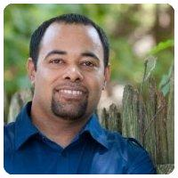


Building Confidence in Your SRE Team
Michael Winslow
Senior Director, Comcast
I still code for my management tasks
@michaelswinslow
michaelswinslow

Slide 2
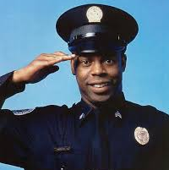
Building Confidence in Your SRE Team
Not that “Michael Winslow”
Senior Director, Comcast
I still code for my management tasks
!=
@michaelswinslow
michaelswinslow

Slide 3

Building Confidence in Your SRE Team
Not that “Michael Scott”
Senior Director, Comcast
I still code for my management tasks
!=
@michaelswinslow
michaelswinslow

Slide 4



@michaelswinslow | #does21

Slide 5
DEVOPS
@michaelswinslow | #does21

Slide 6
S R E
Our Site Reliability Engineers (SRE) will operate software
Our Software Engineers (SWE) will develop software
DEVOPS
@michaelswinslow | #does21

Slide 7

How is this NOT operations?
@michaelswinslow | #does21
"Myriam Gourfink" by dancetechtv is licensed under CC BY-SA 2.0

Slide 8
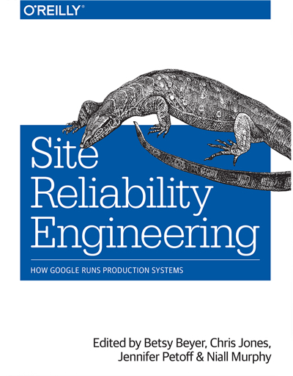
@michaelswinslow | #does21

Slide 9
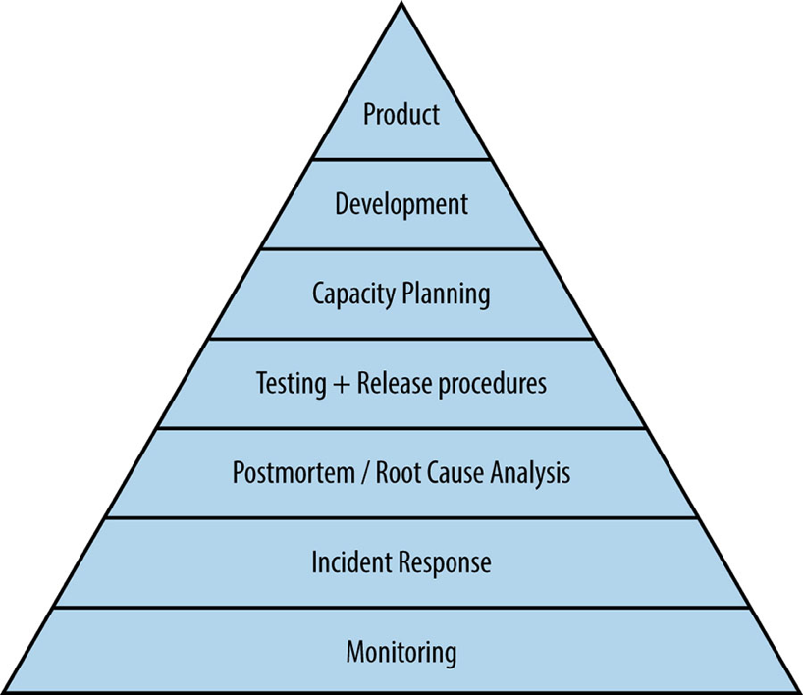
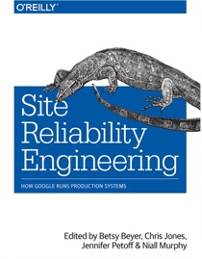
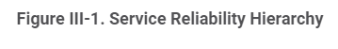
@michaelswinslow | #does21

Slide 10
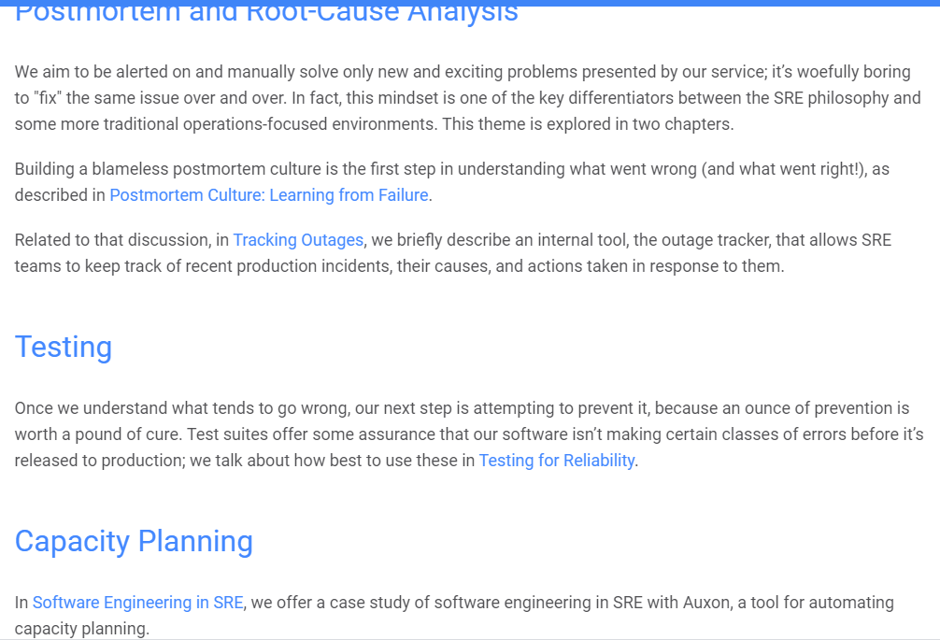
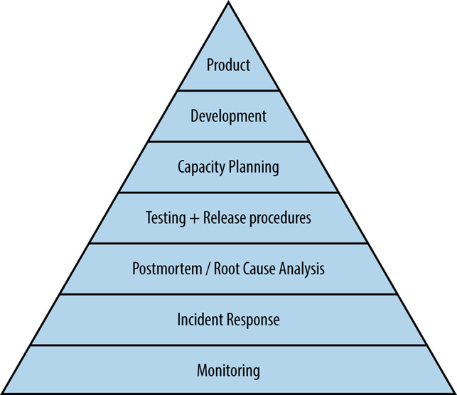

@michaelswinslow | #does21

Slide 11
S R E
+
Our Site Reliability Engineers (SRE) will operate software
Our Software Engineers (SWE) will develop software
DEVOPS
@michaelswinslow | #does21

Slide 12
S R E
+
Our Site Reliability Engineers (SRE) will use DevOps principles to operate and improve software
Our Software Engineers (SWE) will develop software
DEVOPS
@michaelswinslow | #does21

Slide 13
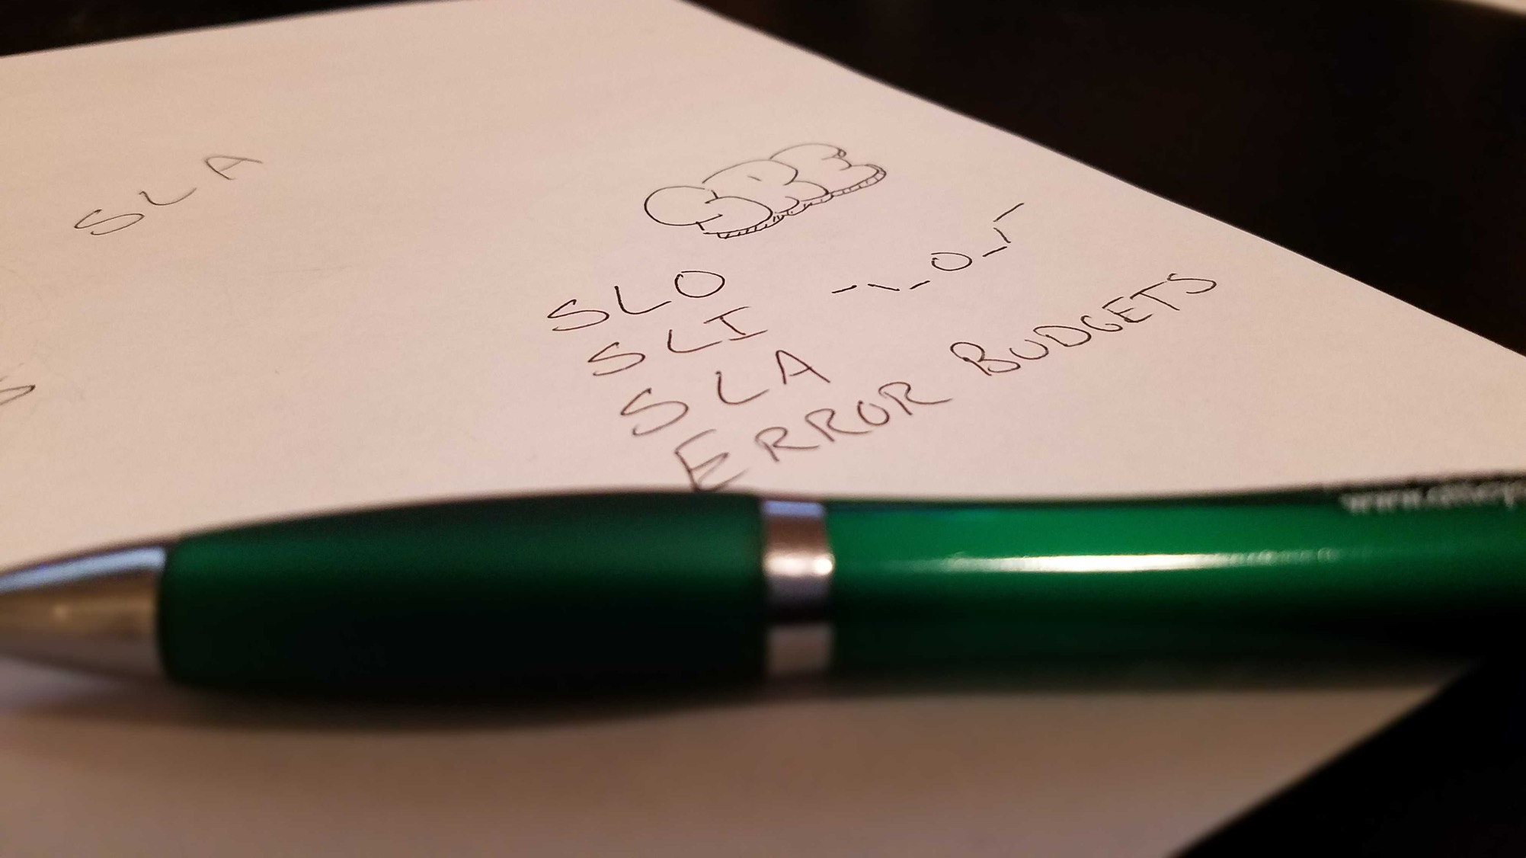
@michaelswinslow | #does21

Slide 14
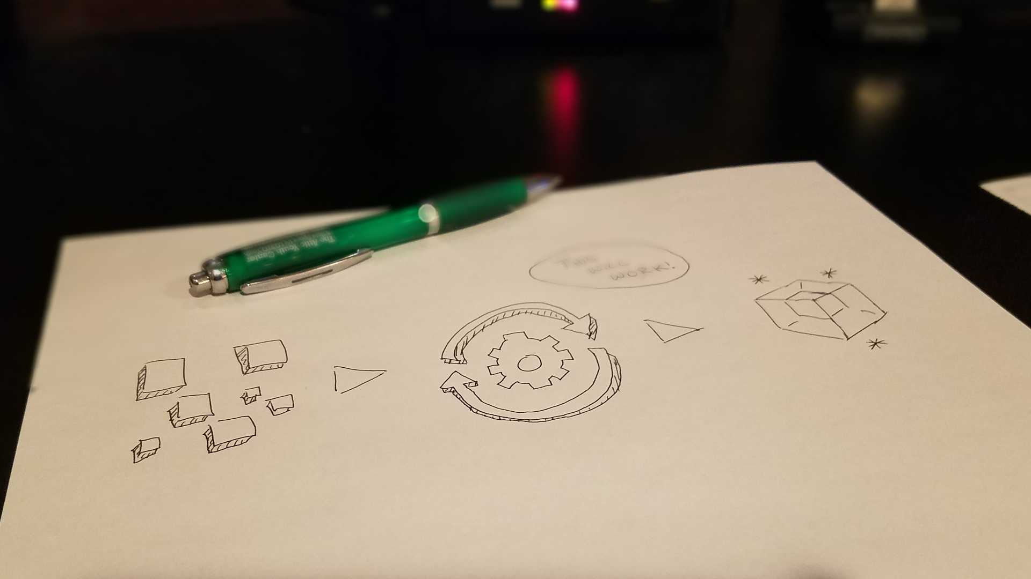
1. AUTOMATION
@michaelswinslow | #does21

Slide 15
“We must automate away the 100s of routine tasks which create the fog that impedes our vision.” – Dana Wilson, SVP of Reliability Engineering, Comcast
@michaelswinslow | #does21

Slide 16

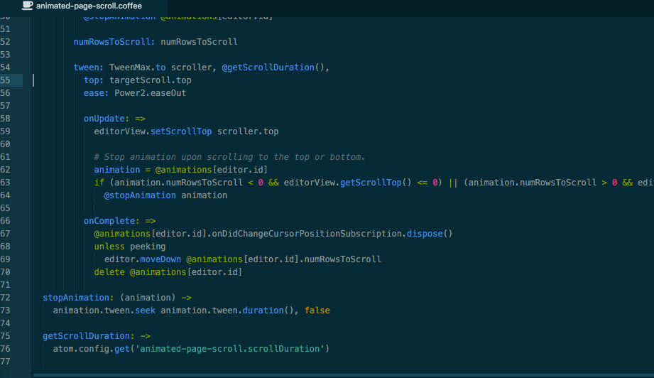
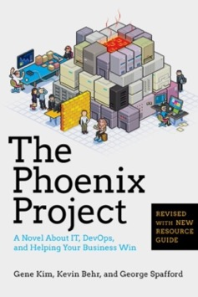
The “Brent” Effect
Brent is your go-to person.
Reliance on one-person impacts people in multiple ways. PMs or Managers want or ask for that resource and are uncomfortable with other resources. This impacts confidence and morale of others in the team.
Brent is so heavily used, he has no time to articulate, share and upskill others in the team. There is a clear dearth of documentation to help others as well. Letting go of Brent is not an option which not only hinders Brent’s growth but also stops others in the team from growing into Brent’s role.
@michaelswinslow | #does21
https://www.blackillustrations.com/
https://medium.com/@rajipillay/the-brent-effect-df10c4c5d3bc

Slide 17

INSTRUCTIONS
Verify Release Notes
Verify release file
Verify with Release Mgr
Inform people before start
Disable VIP
@michaelswinslow | #does21
https://www.blackillustrations.com/

Slide 18
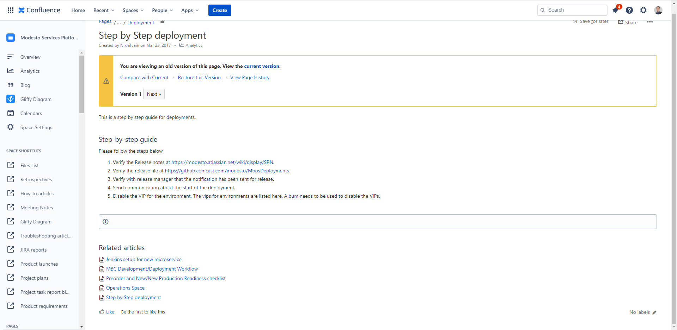
@michaelswinslow | #does21

Slide 19

Trust the Process
1. The engineer executing the runbook (hands on the keyboard) ideally should be one of the junior team members.
2. The “Brent” should be available, but should only help when the junior engineer is stuck.
3. Each time the junior engineer abandons the runbook and seeks guidance from Brent, the third engineer should update the runbook accordingly.
4. Repeat this each time the runbook needs to be executed until the error occurrences a rare.
@michaelswinslow | #does21
https://www.blackillustrations.com/

Slide 20

Process Transfer
1. The engineer executing the runbook (hands on the keyboard) ideally should be one of the junior team members.
2. The “Brent” should be available, but should only help when the junior engineer is stuck.
3. Each time the junior engineer abandons the runbook and seeks guidance from Brent, the third engineer should update the runbook accordingly.
4. Repeat this each time the runbook needs to be executed until the error occurrences a rare.
5. Once process is repeatable, automate.
@michaelswinslow | #does21
https://www.blackillustrations.com/

Slide 21
@michaelswinslow | #does21

Slide 22
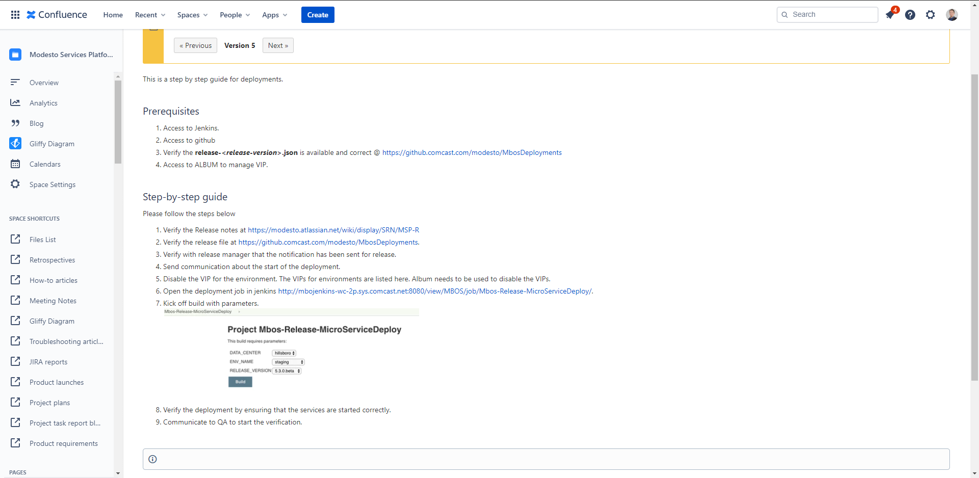
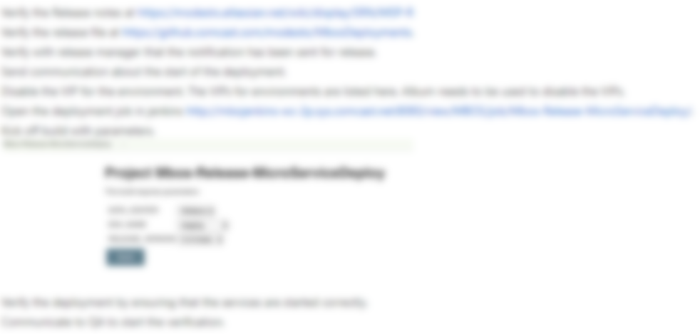
@michaelswinslow | #does21

Slide 23
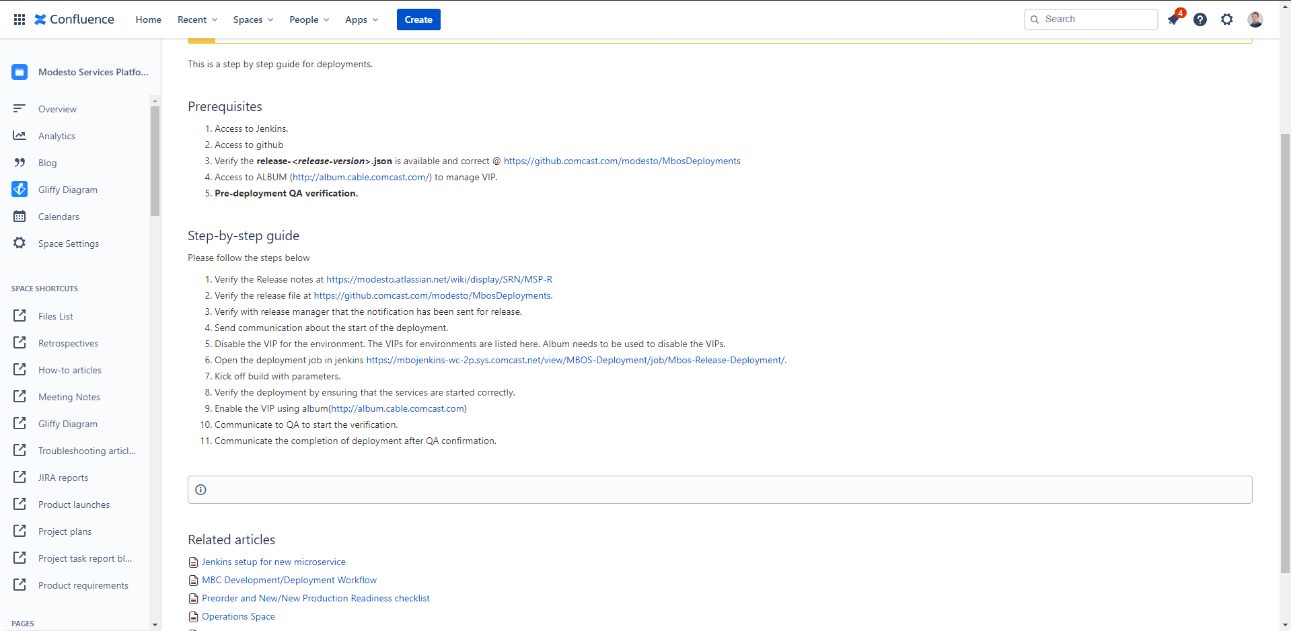
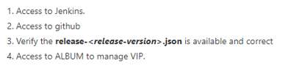
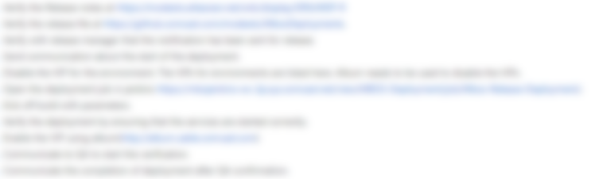
@michaelswinslow | #does21

Slide 24
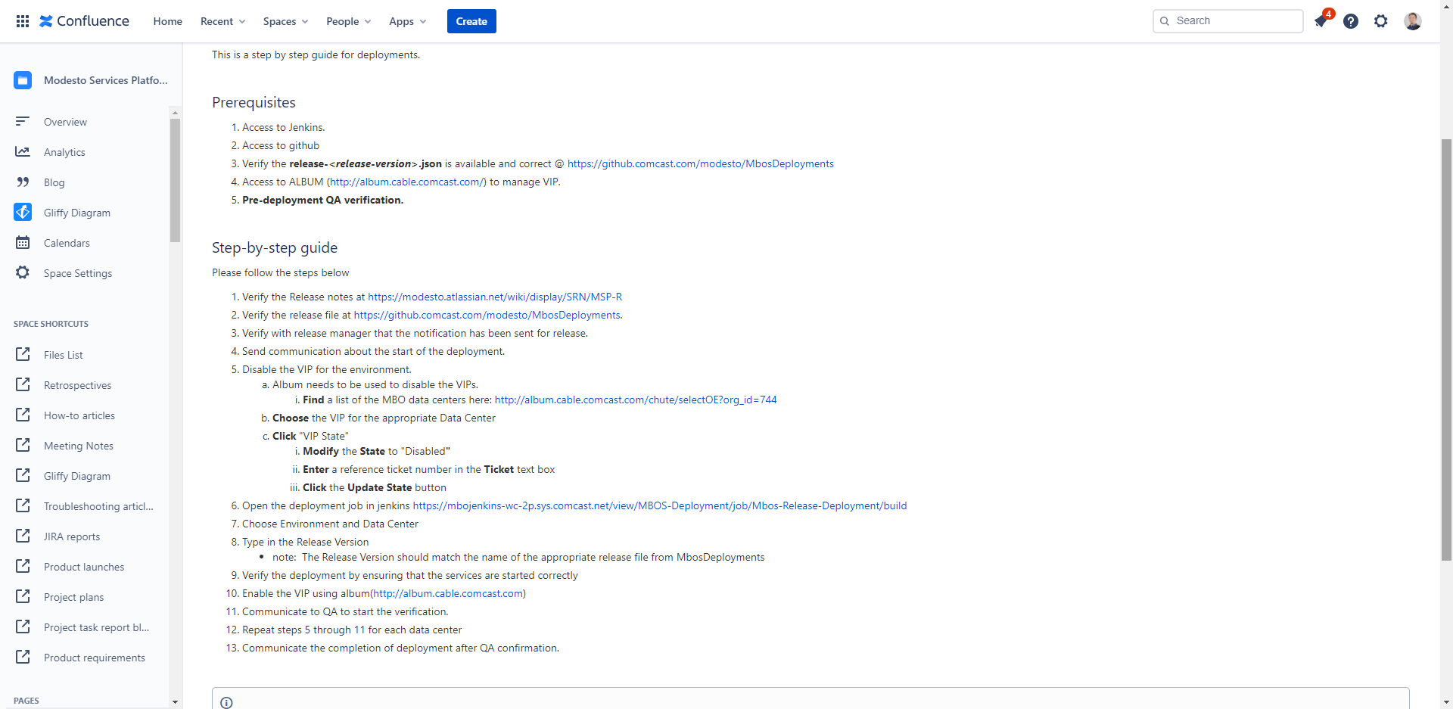
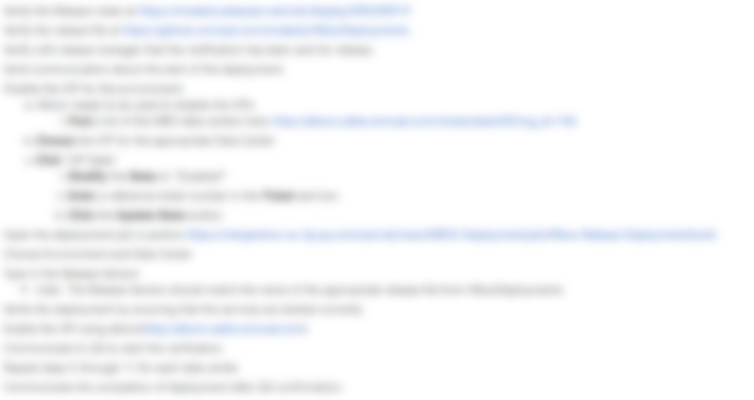
@michaelswinslow | #does21

Slide 25
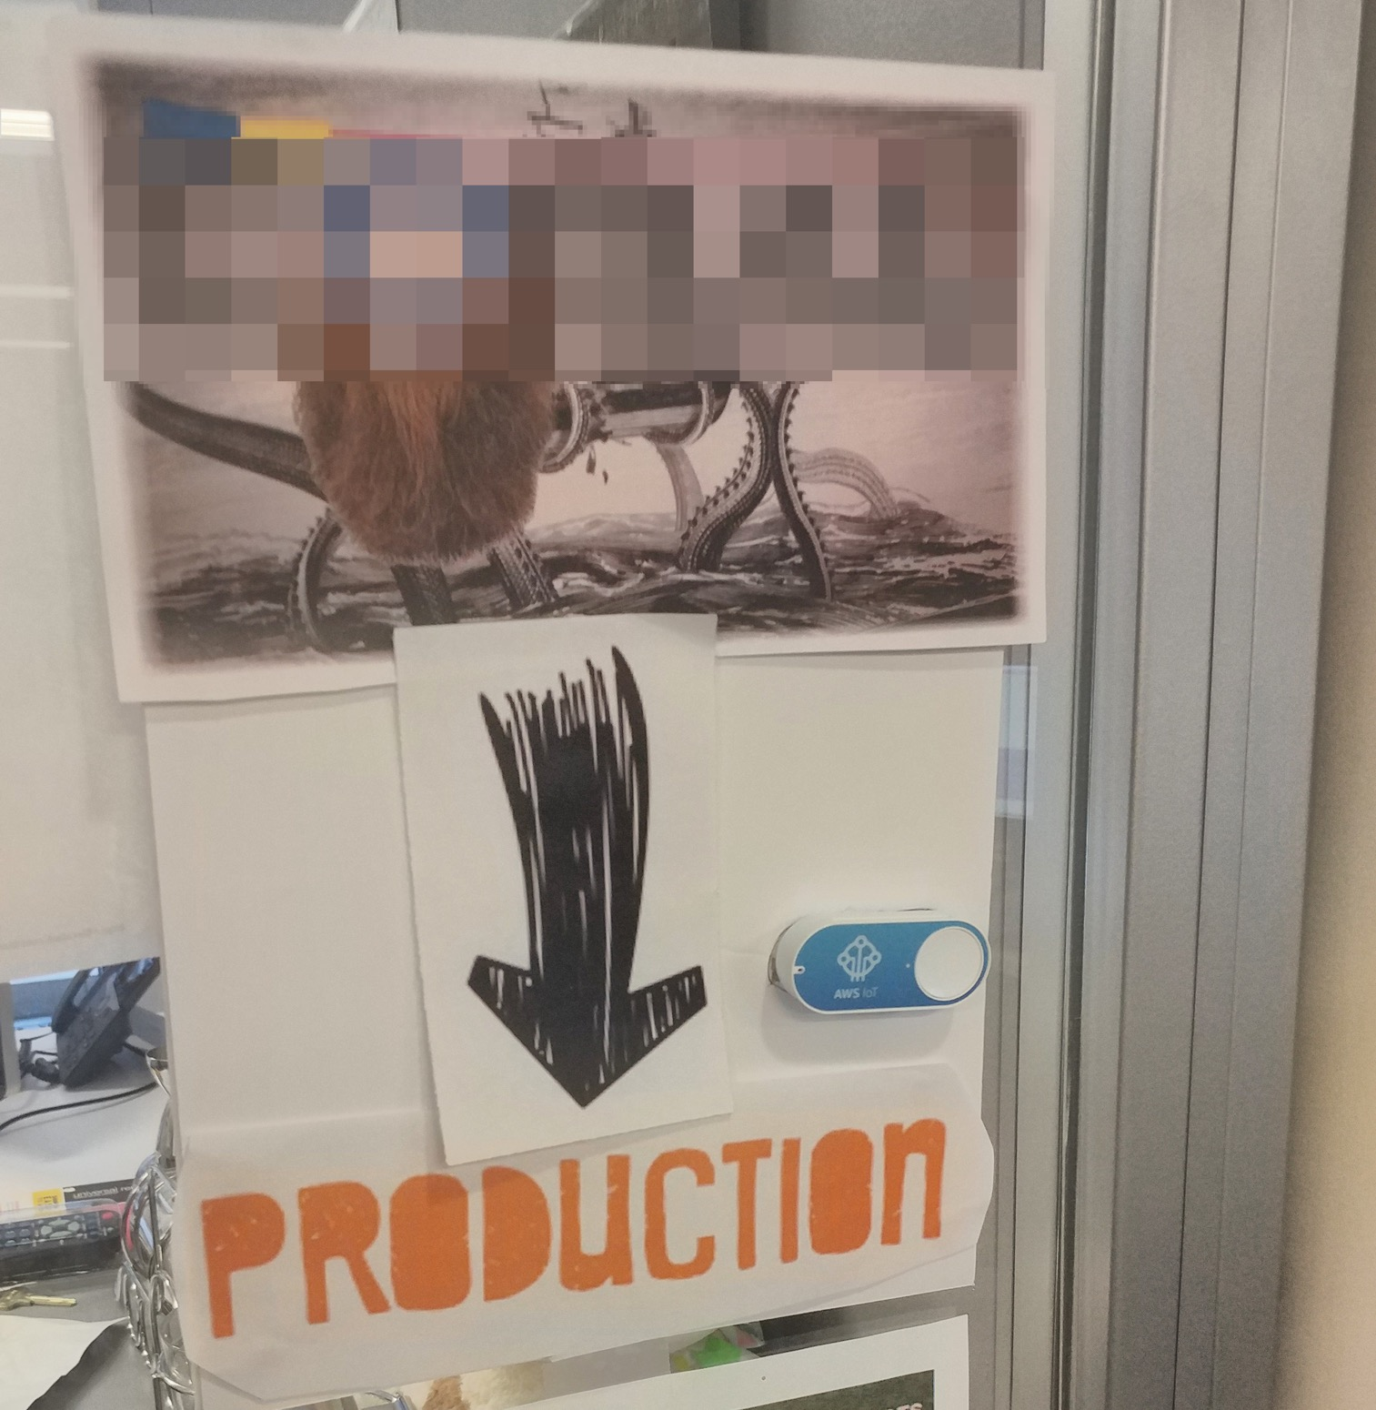
@michaelswinslow | #does21

Slide 26
“What was most amazing to me was how automating our Mobile Back Office deployments positively affected our relationship with other teams. When the Product team was faced with an urgent customer need, we could make the change and deploy it to several environments quickly for review. Delivering our software became a non-event.”– Gustavo Pospischel, VP of Engineering, Comcast (2019)
@michaelswinslow | #does21

Slide 27
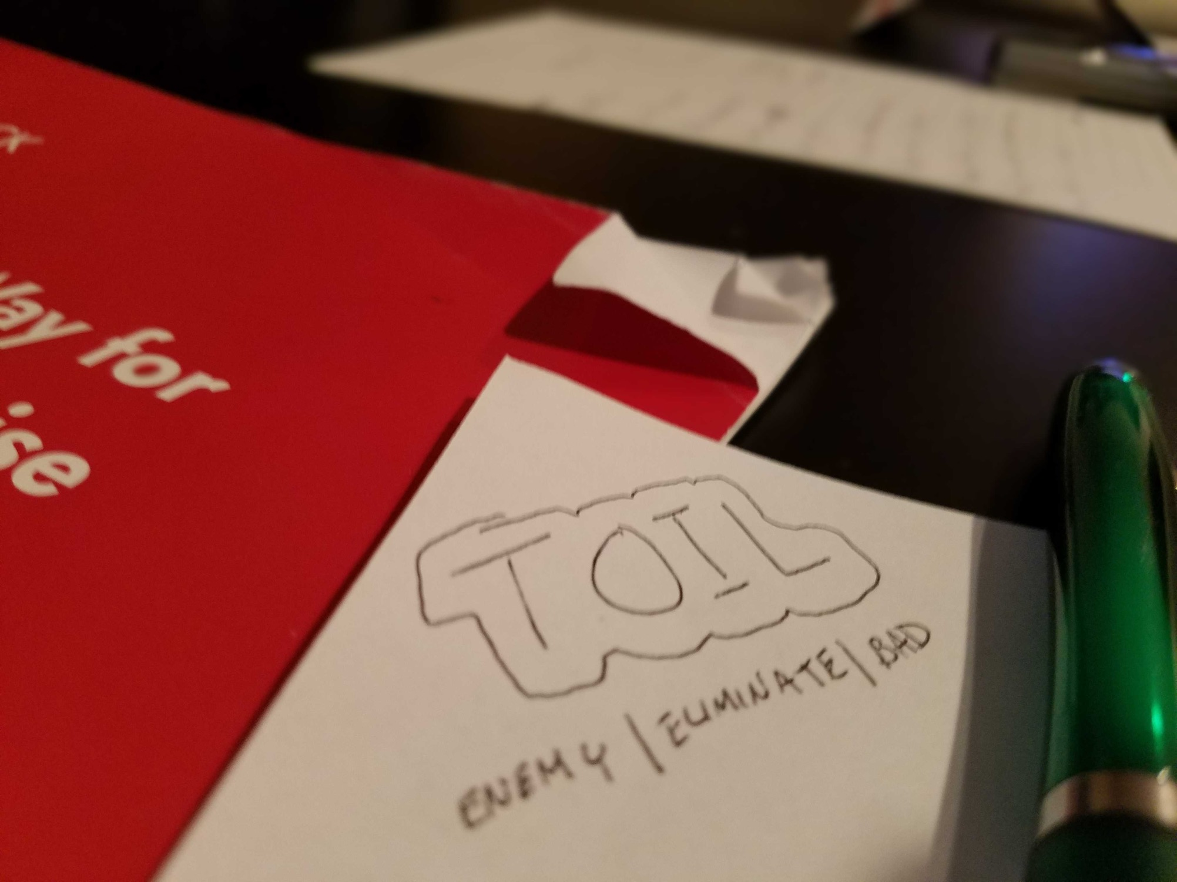

2. REDUCE TOIL
@michaelswinslow | #doe20

Slide 28
“Toil is the kind of work tied to running a production service that tends to be manual, repetitive, and automatable.” – Vivek Rau, Google
@michaelswinslow | #doe20

Slide 29
Finding Time To Reduce Toil
TOIL
Automation
Library
@michaelswinslow | #does21

Slide 30
Finding Time To Reduce Toil
TOIL
Deployment
Deployment
Automation
Library
@michaelswinslow | #does21

Slide 31
Finding Time To Reduce Toil
TOIL
Engineering Work
Deployment
Automation
Library
@michaelswinslow | #does21

Slide 32
Finding Time To Reduce Toil
TOIL
Key Rotation
Engineering Work
Deployment
Key Rotation
Automation
Library
@michaelswinslow | #does21

Slide 33
Finding Time To Reduce Toil
TOIL
Engineering Work
Deployment
Key Rotation
Self Healing
Certificates
Automation
Library
Patches
Release Notes
Testing
Common Support
@michaelswinslow | #does21

Slide 34
Finding Time To Reduce Toil
TOIL
Engineering Work
Deployment
Key Rotation
Self Healing
Certificates
Patches
Release Notes
Testing
Common Support
@michaelswinslow | #does21

Slide 35
Finding Time To Reduce Toil
TOIL
Engineering Work
Monitoring
Dashboards
Alerting
On-Call Rotations
Inventory
IaC
Incident Response
Tool Evaluation
@michaelswinslow | #does21

Slide 36
Finding Time To Reduce Toil
50/50
TOIL
Engineering Work
Monitoring
Dashboards
Alerting
On-Call Rotations
Inventory
IaC
Incident Response
Tool Evaluation
@michaelswinslow | #does21

Slide 37
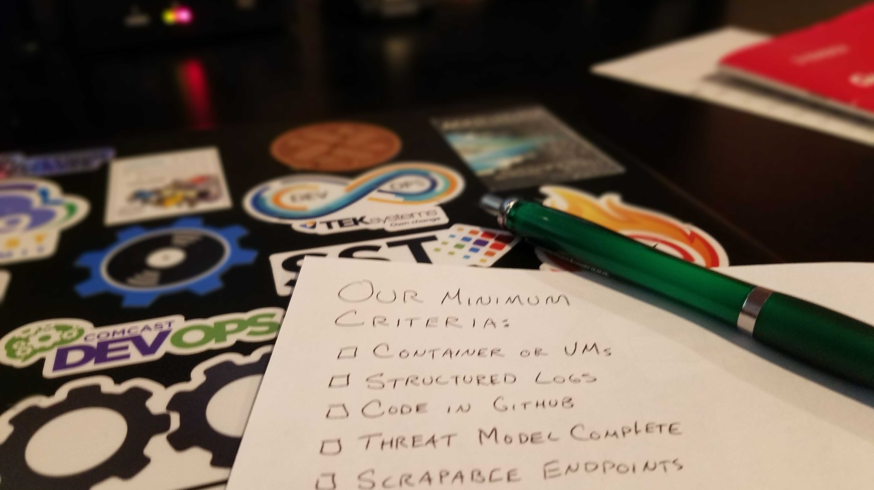

3. BE SELECTIVE
@michaelswinslow | #does21

Slide 38
“If an SRE team cannot regulate its own workload, it becomes the aggrieved party.” – Damon Edwards, PagerDuty
@michaelswinslow | #does21

Slide 39

If handing Off to SRE Was Not a Right
Treat SRE as a premium service
Encourage standards / economy of scale
Fortify your team’s strengths
@michaelswinslow | #does21

Slide 40
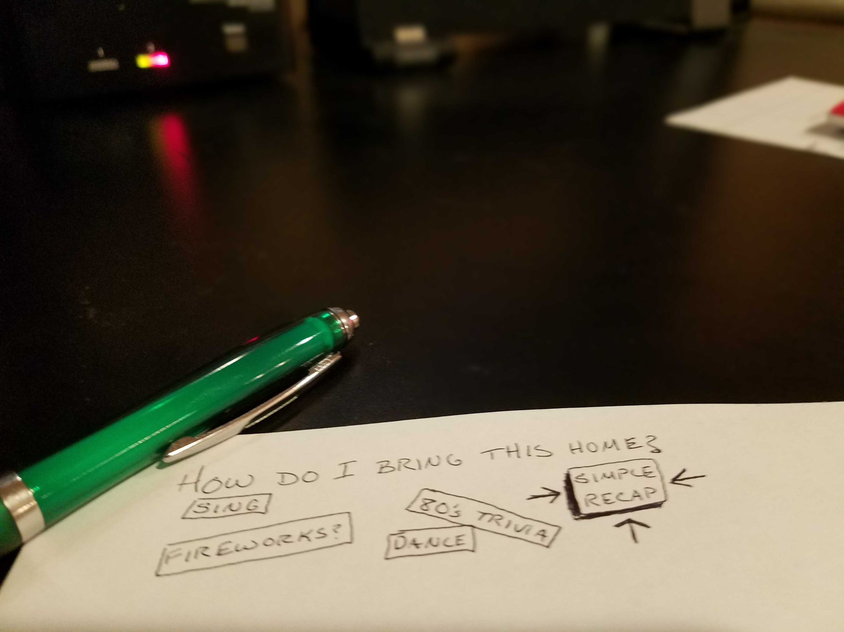
Build your team’s AUTOMATION skills
Track down and eliminate TOIL
Be SELECTIVE and regulate your workload
Confidence in SRE Team:
@michaelswinslow | #does21

Slide 41
Building Confidence in Your SRE Team
Thank You!
@michaelswinslow
michaelswinslow

